Slide 1
A keylogger is a type of surveillance software/hardware that records keystrokes a user makes.
They are often employed with the intention of stealing sensitive information such as passwords and credit card numbers.

Slide 2
Software Keyloggers
Incredibly common in the 2000s - 70% of enterprises infected with keyloggers in 2008
Completely undetectable in some OS’s
Virus protection got better - OS’s more resilient
But are still definitely out there…

Slide 3
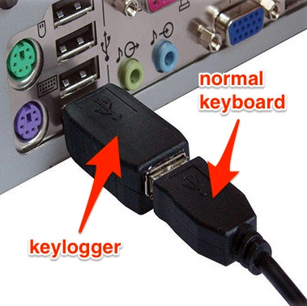
Hardware Keyloggers

Slide 4
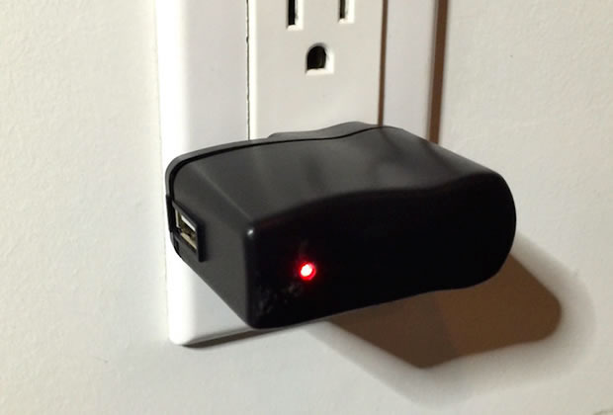
Hardware Keyloggers

Slide 5
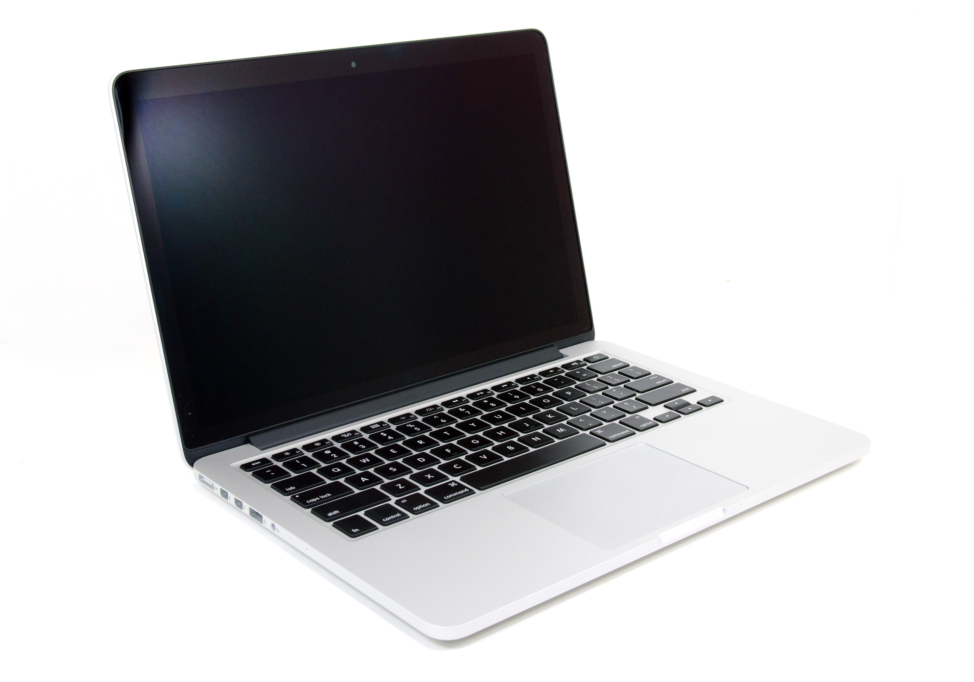

Slide 6


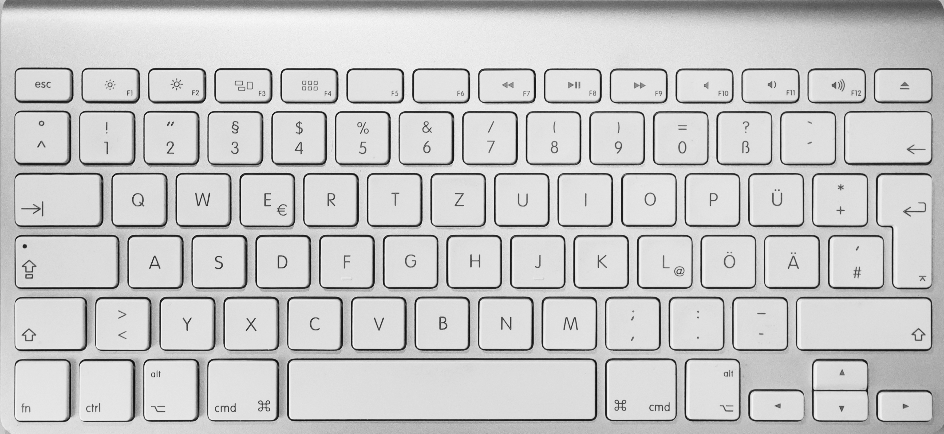

Slide 7
Three researchers (Li Zhuang, Feng Zhou, J. D. Tygar) demonstrated in their paper “Keyboard Emanations Revisited” that they could recover 96% of typed characters from a 10 minute recording of keyboard sounds.
An improvement on the seminal work by Asonov and Agrawal.

Slide 8
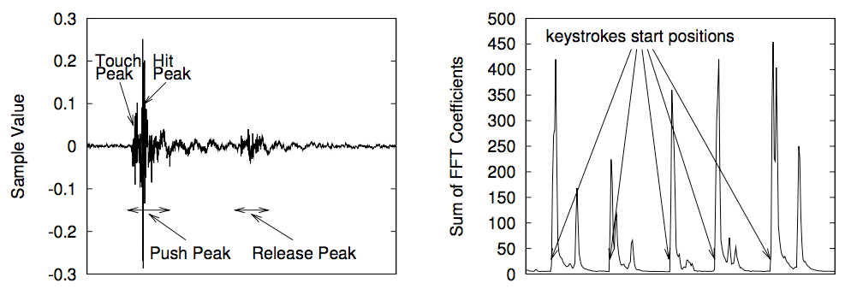
Method

Slide 9
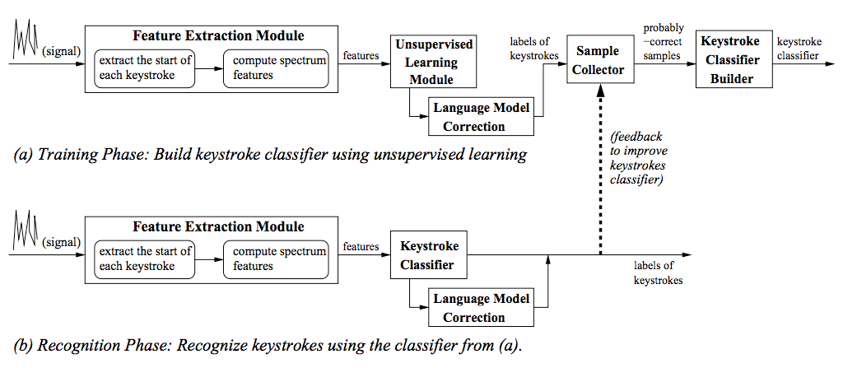
Method

Slide 10
Potential Attack Vectors
iPhone in hand or on table
Recording over conference call
Skype
Hidden microphone/contact microphone
Directional microphone in public space

Slide 11
Demo!

